Slide 1

FOOD IS MEDICINE
AN INTRODUCTION to
INTEGRATIVE NUTRITION
Website
www.anufrench.com
© A New Wellness by Dr. Anu French

Slide 2

Crossroads and Cliffs…
17 years of practicing “conventional pediatrics” the kind of medicine encountered in hospitals and clinics often both expensive, invasive and focused on a quick fix and a prescription. “revolving door”….
Families approaching me with “Alternative medicine" a catch-all term ranging from acupuncture to homeopathy, seemed closer to nature, cheaper and less invasive. But what about safety and efficacy ?
“Complementary" medicine where an alternative medicine practice is used along with a conventional one such as using ginger syrup to prevent nausea during chemotherapy. Together, Complementary and Alternative medicines are often referred to by the acronym CAM.
Integrative medicine.. National Institutes of Health defines as "combines mainstream medical therapies and CAM therapies for which there is some high-quality scientific evidence of safety and effectiveness.“
Professional mid life crisis….I was at a crossroads…which way do I go?
I had reached a cliff…was I ready to jump ?

Slide 3


PHYSICIAN, HEAL THYSELF…
What does it mean to be sick ?
What does it mean to heal?
What does it mean to be well ?
Am I responsible for my health…physical, mental, emotional and spiritual ?
Can I make choices that make me sick ?
Can I make choices that keep me well ?
Do I believe that I can be well ?
Do I believe that I can heal ?
Can I enter into a healing partnership with my patients and their families ?

Slide 4
What is Integrative Medicine ?
Integrative medicine is healing-oriented medicine that takes account of the whole person (body, mind, and spirit), including all aspects of lifestyle. It emphasizes the therapeutic relationship and makes use of all appropriate therapies, both conventional and alternative.
Dr. Andrew Weil MD Founder, Director, Arizona Center for Integrative Medicine
The principles of integrative medicine:
A partnership between patient and practitioner in the healing process
Appropriate use of conventional and alternative methods to facilitate the body's innate healing response
Consideration of all factors that influence health, wellness and disease, including mind, spirit and community as well as body
A philosophy that neither rejects conventional medicine nor accepts alternative therapies uncritically
Recognition that good medicine should be based in good science, be inquiry driven, and be open to new paradigms
Use of natural, effective, less-invasive interventions whenever possible
Use of the broader concepts of promotion of health and the prevention of illness as well as the treatment of disease
Training of practitioners to be models of health and healing, committed to the process of self-exploration and self-development

Slide 5

Inflammation is the new bad guy….
Chronic inflammation is the root cause of serious illness.
It damages the body and can lead to obesity, heart disease, cancer, autoimmune disease, mental illness and many more.
Dietary choices play a big role.
Stress, lack of exercise, genetic predisposition, poor sleep, exposure to toxins can all contribute to chronic inflammation.

Slide 6
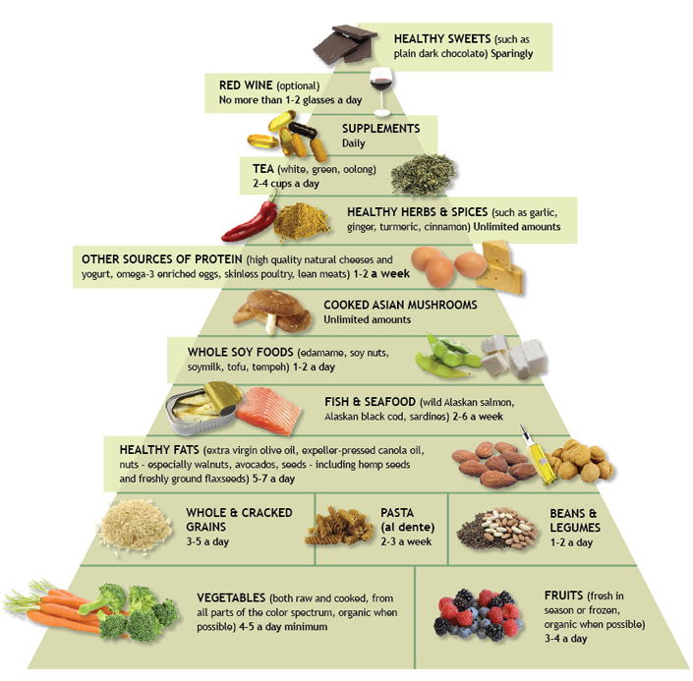
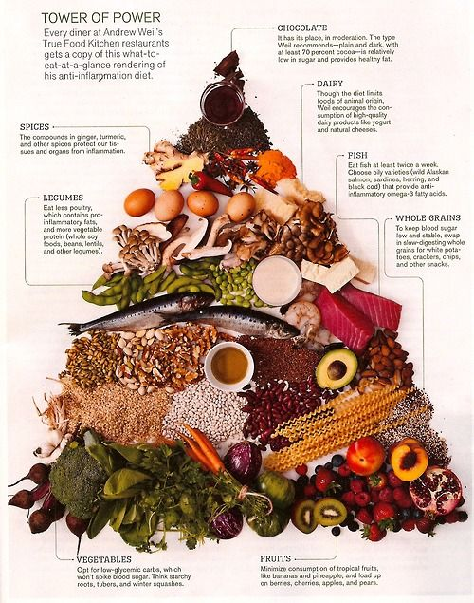
The Anti-Inflammatory Diet

Slide 7
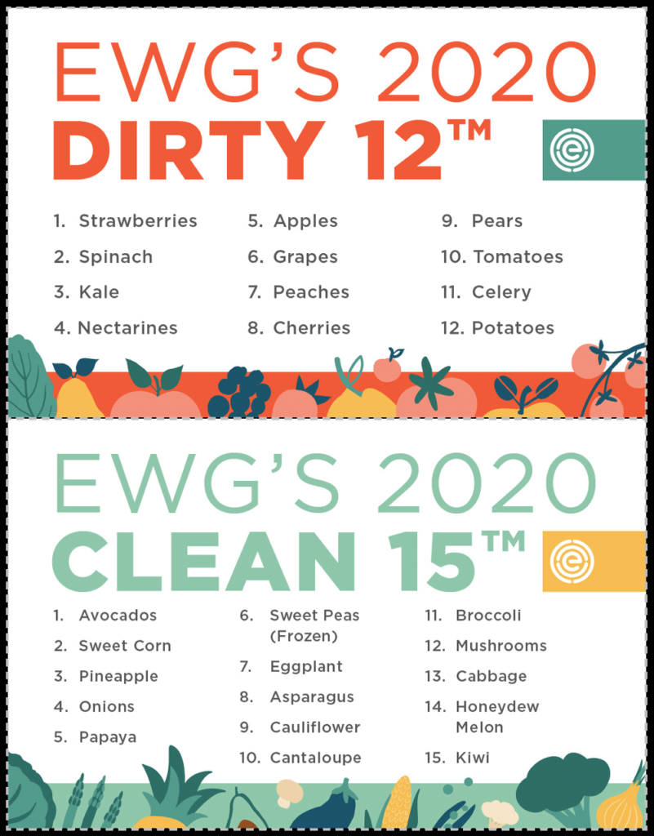
The Dirty Dozen. The Clean Fifteen
The Dirty Dozen
Produce that should be purchased organically:
The Clean Fifteen
Does not need to be organic
https://www.ewg.org/foodnews/

Slide 8


Eat Fat, Get Thin
Dr. Mark Hyman
Sugar, not fat, makes you fat.
Dietary fat is more complex than sugar.
Low-fat diets tend to be heart-unhealthy, high-sugar diets.
Saturated fat is not your enemy but in moderation.
Some fats are unhealthy. They include trans fat and inflammatory vegetable oils.
Everyone benefits from more omega 3s.
Eating fat can make you lean.
Good fats can heal.
Your brain is about 60 percent fat and needs DHA an Omega 3 FA
Your body gives you signs whether or not you are getting enough quality fat.
Dry, itchy, scaling, or flaking skin
Soft, cracked, or brittle nails
Hard earwax
Tiny bumps on the backs of your arms or torso
Achy, stiff joints
http://www.eatfatgetthin.com/
Notes:
The average American eats 152 pounds of sugar and 146 pounds of flour that converts to sugar every year. Your body pumps out more and more insulin to pull your blood sugar levels back down. You can’t burn all the sugar you eat. Inevitably, your body stores it as fat, creating insulin resistance and overall metabolic havoc among other mayhem.

Slide 9
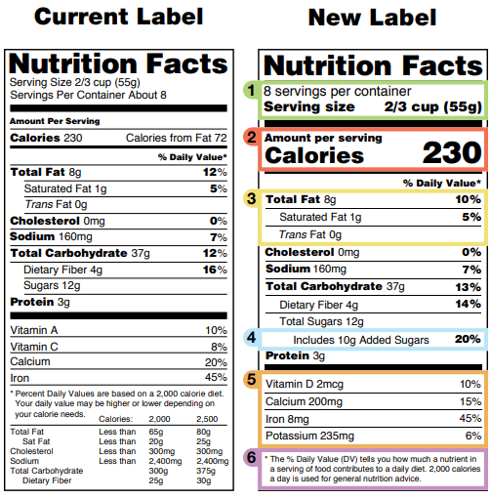
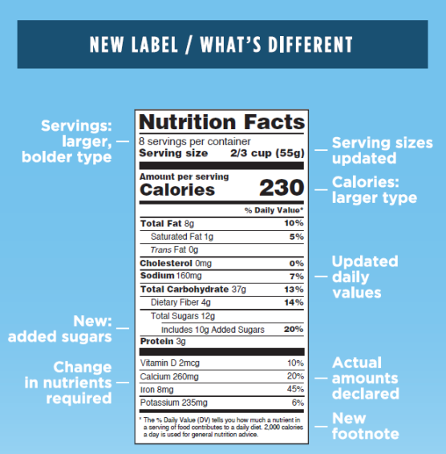
2020 New FDA Food Labels
http://www.fda.gov/Food/GuidanceRegulation/GuidanceDocumentsRegulatoryInformation/LabelingNutrition/ucm385663.htm

Slide 10

Supplements
Why: Supplements help fill any gaps in your diet when you are unable to get your daily requirement of micronutrients.
Whole foods are always the best source.
High quality Multivitamin/multimineral that includes key antioxidants SmartyPants, Renzo
Omega 3 fatty acids A molecularly distilled mercury free fish oil or flaxseed oil providing both EPA and DHA in a dose of 1-2 grams per day : essential for brain eye and nervous system development, helping focus attention they are also beneficial for cardiac and mental health. Nordic Naturals
Vitamin D 3 : This is not only important for our bones and teeth but supports your immunity, mental and lung health. Sunlight and diet are sometimes not an adequate source and supplements of about 1000- 2000 iu are needed daily. Carlsons
Probiotics taken daily are the ‘good bacteria’ that help balance the health of your gut; this prevents food allergies, indigestion, stomach viruses, and bowel irregularities and supports immune function and mental health. Culturelle 5-10 billion CFU’s a day
Magnesium deficiency in almost 80% of US residents, is a cofactor in more than 300 enzyme systems that regulate diverse biochemical reactions in the body, including protein synthesis, muscle and nerve function, blood glucose control, and blood pressure regulation. NatureCalm
To check how good your supplements are
https://www.consumerlab.com/
To learn more about supplements
www.drweilvitaminadvisor.com

Slide 11
MINDLESS EATING
Do these habits sound familiar?
Eating until you are too full and then feeling guilty
Emotional eating – eating when you are bored, stressed or anxious rather than hungry
Grazing on food without really tasting it
Mindlessly munching on snacks while zoned out in front of the TV or a tablet
Eating a meal at the same time each day whether you are hungry or not
Skipping meals, not paying attention to your hunger signals
MINDFUL EATING
1. Get Focused. Turn off the television or radio, put away the magazine, and clear the table of clutter.
2. Slowdown. Make it your intention to be a slow eater…Simply pay attention.
3. Breathe Deep. Take five to 10 long, slow breaths at the start of each meal to center and focus
4. Bless The moment. Offering gratitude for your meal can also serve as a reminder of the network of people and natural forces that connects and sustains us.
5. Use All Your Senses. Notice the appearance, texture, and aroma of food before you even put it in your mouth. Then taste it, feeling it on your tongue and against your teeth as you chew, and pay attention to every nuance.
6. Notice Everything. : How are you holding your fork? What music or conversation can you hear in the background? Is the food triggering any memories or emotions?
7. Expand Your Horizons. . Try eating with chopsticks, testing new recipes or restaurants, or discovering exotic foods and spices at ethnic groceries

Slide 12

Obesogens
By mimicking the actions of naturally occurring hormones
in our bodies or preventing the hormones we produce from acting correctly, endocrine disruptors can:
Encourage the body to store fat and re-program cells to become fat cells.
Prompt the liver to become insulin resistant, which makes the pancreas pump out more insulin that turns energy into fat all over the body.
Prevent leptin (a hormone that reduces appetite) from being released from your fat cells to tell your body you are full.
How to avoid obesogens:
Buy wild fish (such as salmon, which is packed with heart-healthy omega-3 fatty acids) and meat products that are hormone- and antibiotic free.
Install a granular activated carbon filter on your faucet to filter out chemicals.
Use aluminum water bottles or those that are BPA-free.
Steer clear of plastics with the number 3 or 7 on the bottom, which may leach BPA. Instead look for the numbers 1, 2, 4, 5, and 6, which are unlikely to contain BPA.
Keep water bottles cool (warm temperatures increase BPA leaching) and never microwave plastic.
Eat fewer canned foods. Opt for frozen or fresh instead. Tuna can be found in pouches that do not contain BPA.
Get rid of your non-stick pans if possible. Try Ceramic. If you must use a Teflon pan, never use a metal implement on it that can scratch the surface and release the chemicals inside, and throw away any scratched non-stick pans.
Buy meats straight from the butcher counter (instead of pre-packaged) and ask that they wrap them in brown paper.
Skip the air fresheners, open the windows, and try a vase of dried lavender instead.
http://www.ncbi.nlm.nih.gov/pmc/articles/PMC3279464/

Slide 13

Resources
http://www.leannebrown.com/
http://www.stlmetromarket.com/
http://www.earthdancefarms.org
http://www.drweil.com/videos-features/anti-inflammatory-diet-pyramid/dr-weils-anti-inflammatory-food-pyramid/

